Slide 1



Final Project Presentation
Terrell Sampson
CST 499 Capstone for Computer Software Technology
Instructor Amr Elchouemi
September 13, 2021

Slide 2
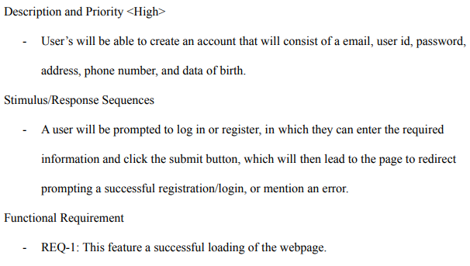
SRS Document Key Aspects
“A software requirements specification is the basis for your entire project. It lays the framework that every team involved in development will follow” (Krüger, 2018).
Will list elements like system features (Functional Requirements).
Defines the overall goal of creating the software (Scope).

Slide 3
UML Diagrams
Unified Modeling Language will be the main modeling language that will allows the overall design of the software to be created which in turn helps with building later on.
“Class diagrams and object diagrams, in particular, are useful to us when describing the properties, methods, and relationships between classes and objects” (Connolly & Hoar, 2018, p. 585).
There are many different types of UML diagrams that are used during the designing phase.
During the designing of the Online Enrollment System a few main type of UML diagrams used were the Class Diagram, State Diagram, and a few others.

Slide 4
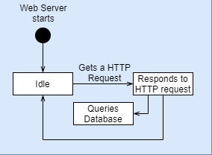
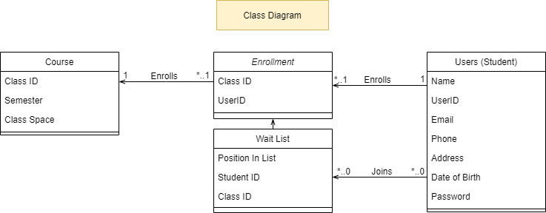
UML Diagrams
Class Diagrams will show different components of the system in relation to others.
State Diagrams depict the systems behavior.
Sequence Diagrams show user interactions with the system.
Activity Diagram shows a possible use case, as in how a process should occur in the system.
Use Case Diagram will show all possible uses of the system a user will able to do with the system.

Slide 5
Landing, Login, and Register
During the creation of this enrollment system, we first create the Landing Page which is where users will start when opening the website (This is the Login Page)
Creation of the register page is next to allow for user to sign up and utilize the login page created.
Instead of Landing Page being a home page, we reserved the Home page for after login.
Users shouldn’t be able to access home page without being logged in.

Slide 6
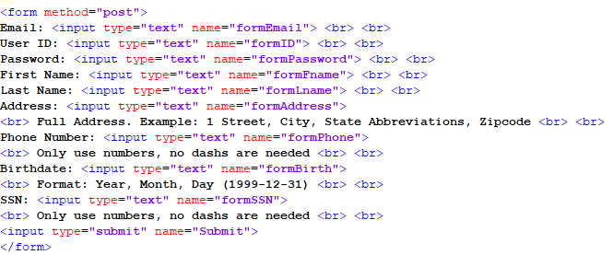
Landing, Login, and Register
Outside from sending Login or Register data to data base, the main code behind the creation of these three pages was HyperText Markup Language (HTML).
PHP is only used for Database interactions (will be discussed more in the next section).

Slide 7
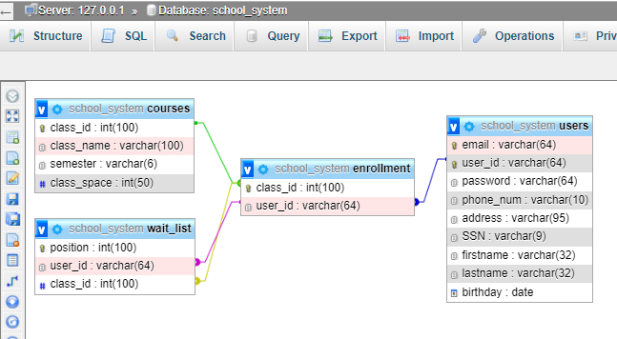
MySQL database and class registration
Database will be used to store and retrieve data from the website that will be used for display or other functional requirement.
This database will hold information for each of the classes displayed in the UML Class Diagram and link the tables together in the same way.

Slide 8
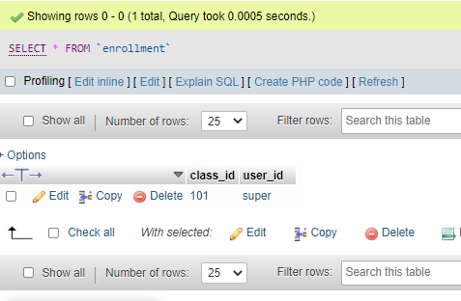
MySQL database and class registration
When a user registers, it takes primary keys from user and course tables, and adds that into enrollment table. (Courses Enrollment Page)
Enrollment Table will be used to track user Enrollment (Profile Page).

Slide 9
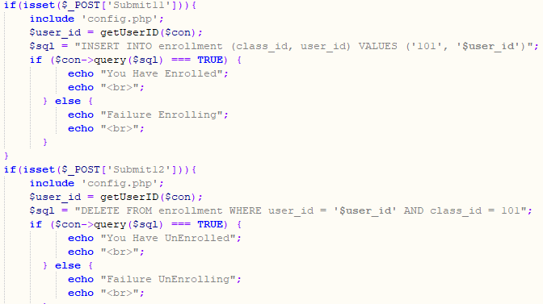
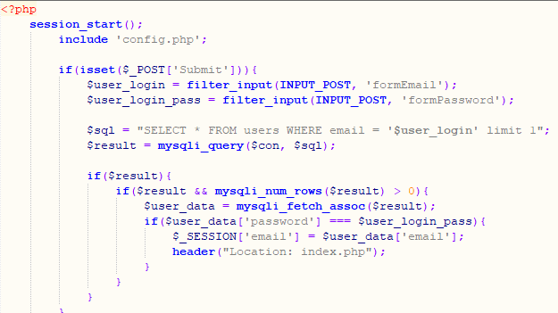
PHP code
PHP code is dynamic, which is something that HTML isn’t.
“The web server executes the PHP code and embeds its output in the HTML file that is sent to the browser” (Tzui et al., 2018, p. 164).
Will handle all the communication between Database and Website that user interacts with.

Slide 10
References
Krüger, N. (2018, October 23). How to write a software requirements specification (SRS document). Perforce. https://www.perforce.com/blog/alm/how-write-software-requirements-specification-srs-document
Connolly, R., & Hoar, R. (2018). Fundamentals of web development (2nd ed.). Pearson.
Tsui, F., Karam, O., & Bernal, B. (2018). Essentials of software engineering (4th ed.). Jones & Bartlett Learning.

